Slide 1

Mobility Introduction
Overview

Slide 2
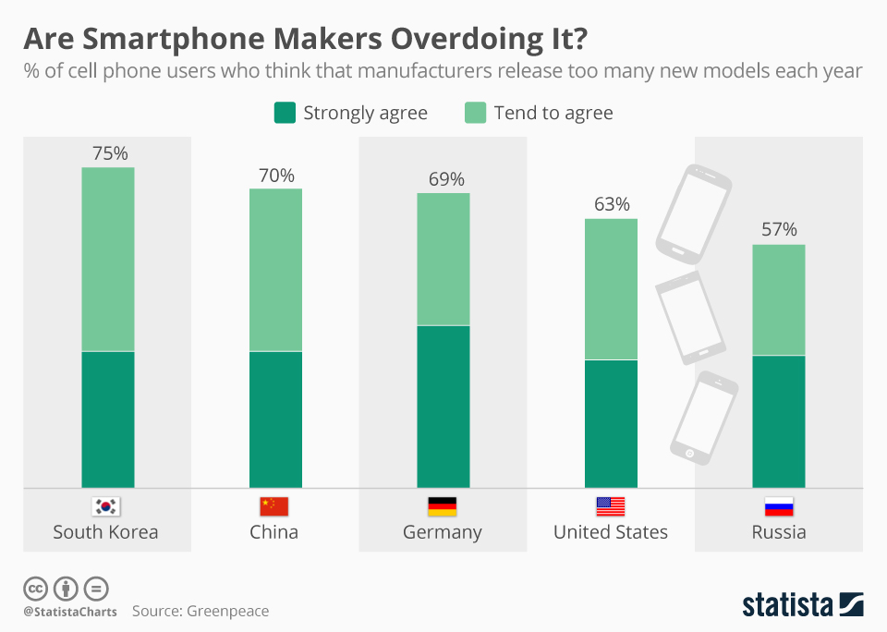
Pushing it to the Limits?

Slide 3
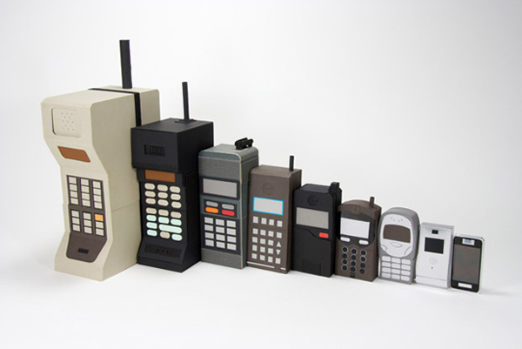
Oh my how the times have changed!

Slide 4


MOBILE history
Click here

Slide 5

Can’t forget about VR/AR!

Slide 6
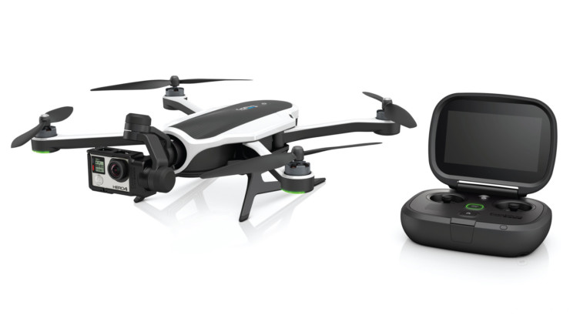
And how about…

Slide 7
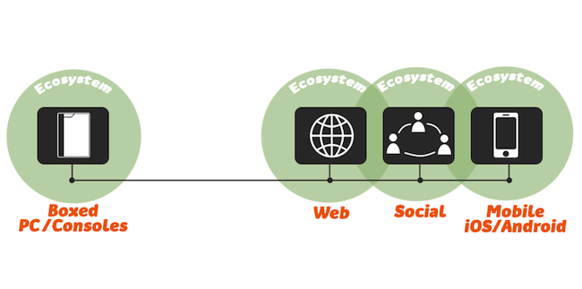
MOBILE TIMELINE

Slide 8
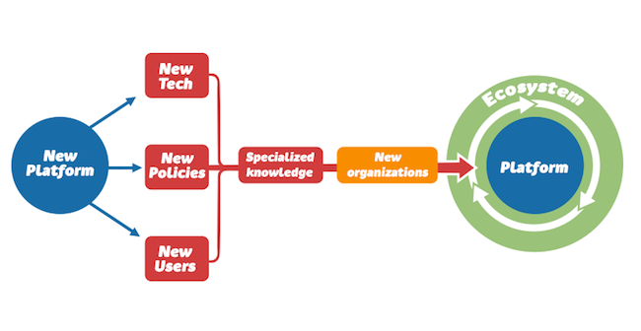
MOBILITY’S BRAVE NEW WORLD

Slide 9

APP WARS!

Slide 10
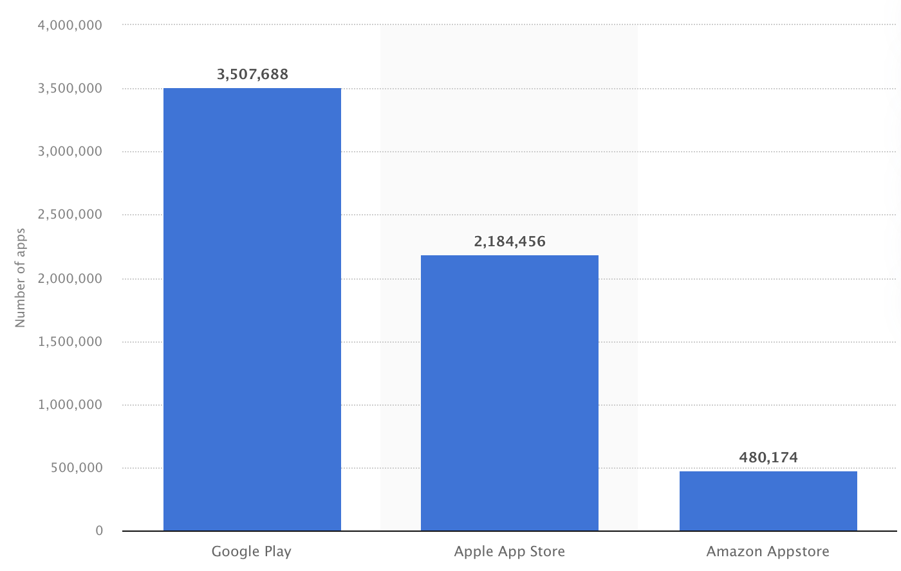
APP WARS - 2022!

Slide 11
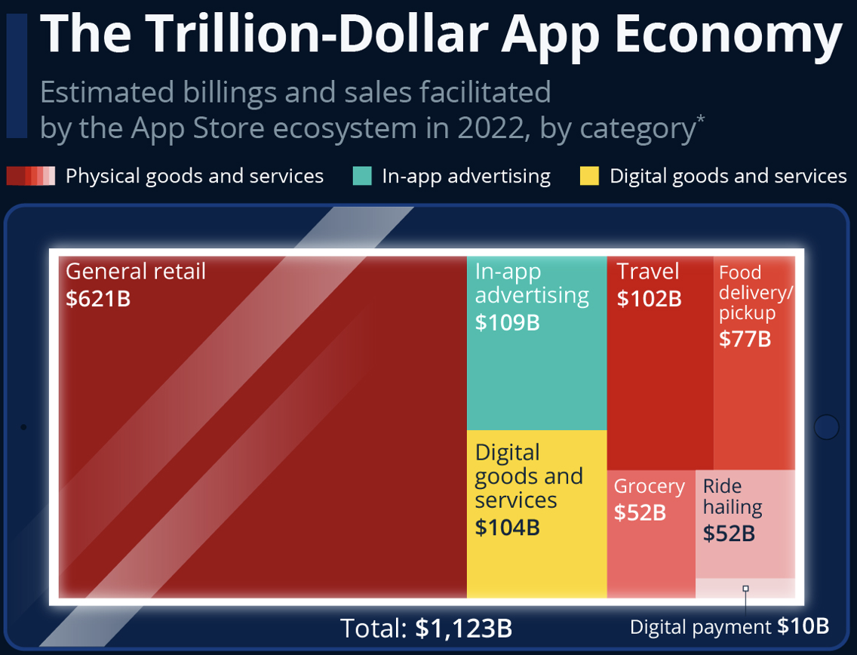
APP WARS!

Slide 12
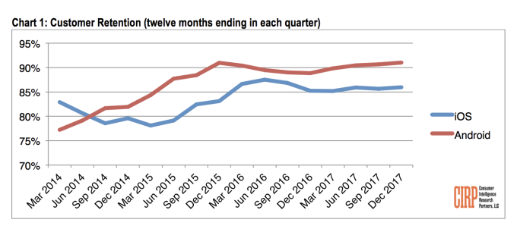

Slide 13
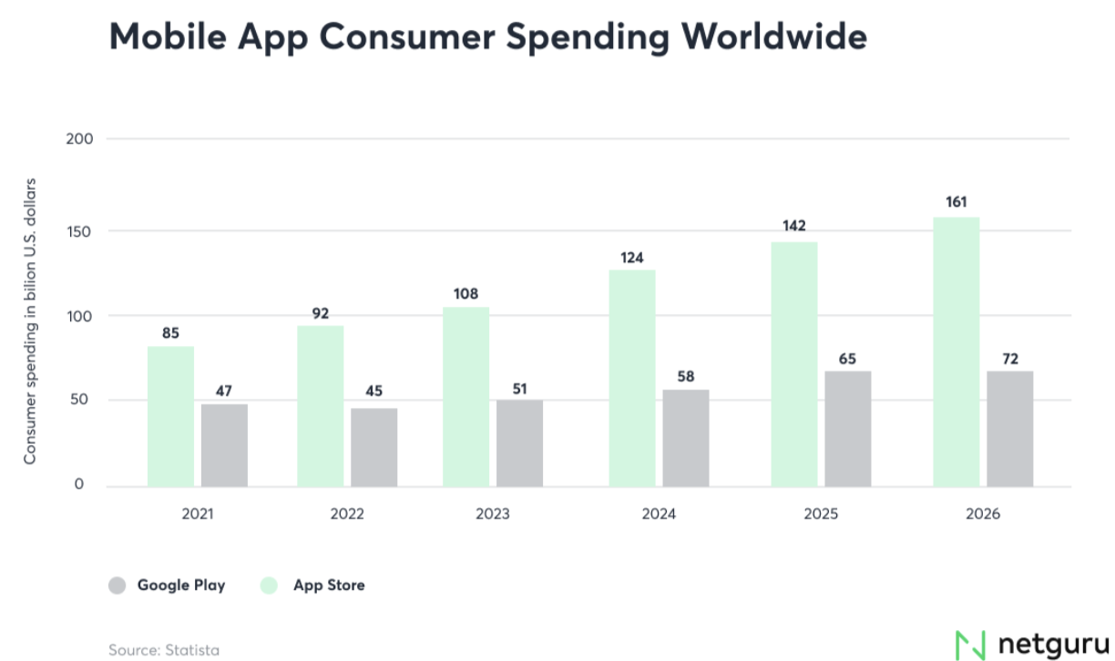

Slide 14
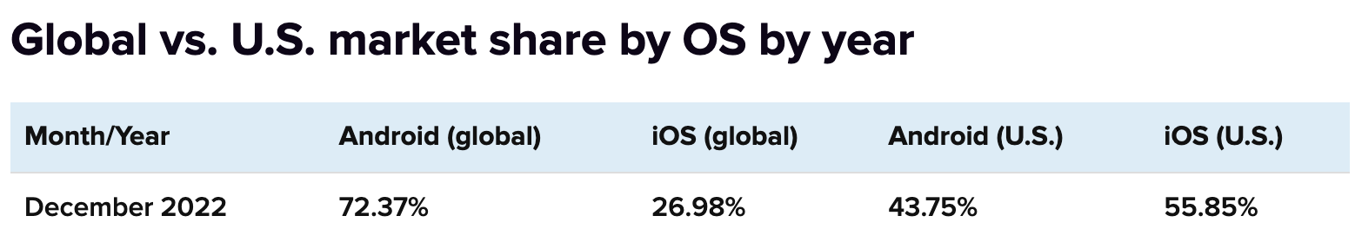

Slide 15

Personal Uses

Slide 16
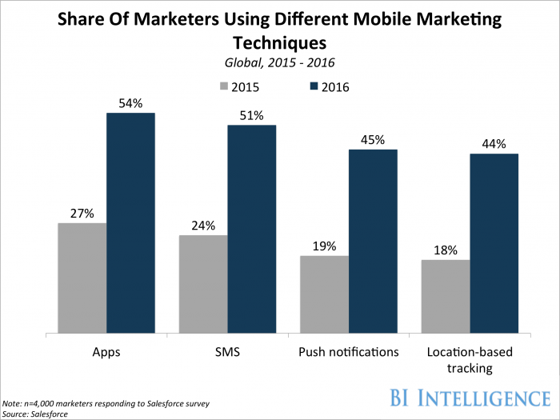
Personal Uses

Slide 17
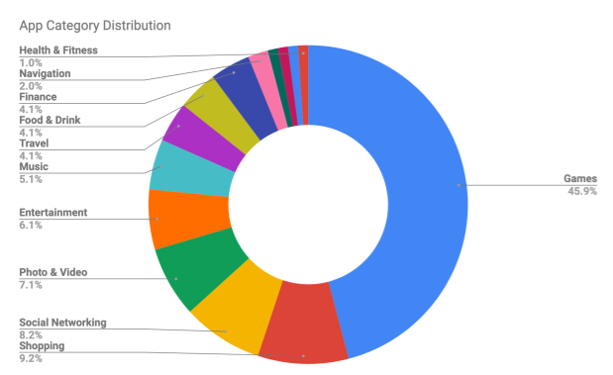
The update landscape

Slide 18
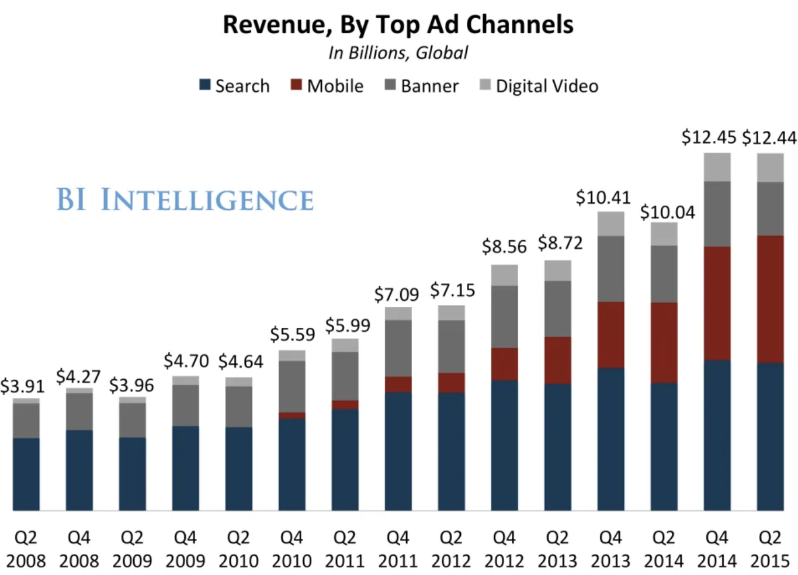
Personal Uses

Slide 19
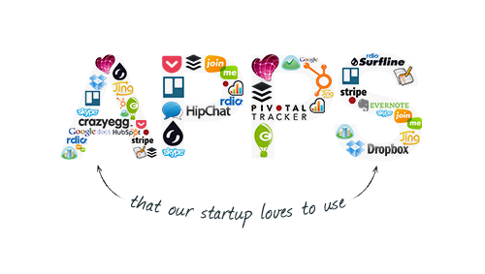
Business Uses

Slide 20
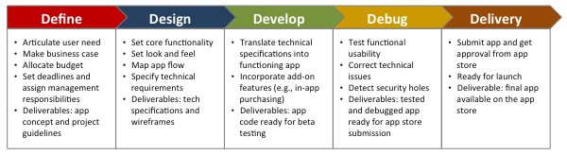
System Analysis/Development

Slide 21
App costs
App functionality and purpose – what an app will actually be capable of doing for its users.
Mobile platforms and devices are supported – whether an app will be developed for iOS only or has an Android / Windows Mobile version as well. What specific devices will it support, e.g. iPhone 6S, iPhone 6S+, Samsung Galaxy S6 and so on.
Integration points – will an app be integrated with third party apps that will be the source of its content.
Use of visual objects – complexity of visual objects inside of an app will significantly influence the cost.
Use of a smartphone hardware features – whether an app will be using such smartphone features as GPS navigation, NFC technology, motion co-processor and other technologies that are packed into smartphones or tablet computers.
Maintenance plan – once an app development project is over, certainly it will require a technical support from its developer.

Slide 22
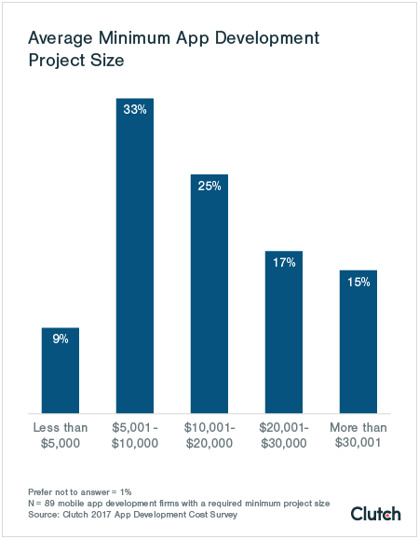

Slide 23
Mobile App Dev jobs
Job Market
Cool app ideas: https://www.apple.com/business/enterprise/success-stories/transportation/united/

